Slide 1

NODE JS
Aruna S
Department of
Computer Science and Engineering

Slide 2

NODE JS
Cluster and Child Process
S. Aruna
Department of Computer Science and Engineering

Slide 3
NODE JS
Child_Process Module
Node.js runs in a single-thread mode, but it uses an event-driven paradigm to handle concurrency.
It also facilitates creation of child processes to leverage parallel processing on multi-core CPU based systems.
Child processes always have three streams child.stdin, child.stdout, and child.stderr which may be shared with the stdio streams of the parent process.
Node provides child_process module which has the following four major ways to create a child process.
exec(),execFile(),spawn(),fork()

Slide 4
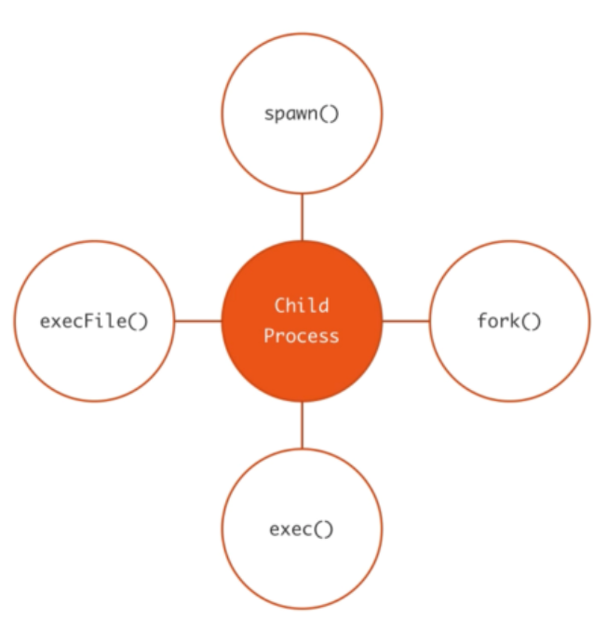
NODE JS
Child_Process Module

Slide 5
NODE JS
Child_Process Creation Ways
The exec() Method
This method runs a command in a shell and buffers the output.
child_process.exec(command[, options], callback)
The spawn() Method
This method launches a new process with a given command.
child_process.spawn(command[, args][, options])
The fork() Method
This method is a special case of spawn() to create Node processes.
child_process.fork(modulePath[, args][, options])

Slide 6
NODE JS
Cluster Module
One of the important and often less highlighted features of Node.js is its scalability.
In fact, this is the main reason why some large companies with heavy traffic are integrating Node.js in their platform
Each Node.js process runs in a single thread and by default it has a memory limit of 512MB on 32-bit systems and 1GB on 64-bit systems.
The elegant solution Node.js provides for scaling up the applications is to split a single process into multiple processes or workers, in Node.js terminology.
This can be achieved through a cluster module. This module allows us to create child processes (workers), which share all the server ports with the main Node process (master).

Slide 7
NODE JS
Cluster Module
A cluster is a pool of similar workers running under a parent Node process.
Workers are spawned using the fork() method of the child_processes module.
This means workers can share server handles and use IPC (Inter-process communication) to communicate with the parent Node process.
The master process is in charge of initiating workers and controlling them. You can create an arbitrary number of workers in your master process.
By default it is Round Robin approach
To start using it, you have to include it in your Node.js application:
Var cluster = require(‘cluster’);

Slide 8
NODE JS
Cluster Module
A cluster module executes the same Node.js process multiple times. Therefore, the first thing you need to do is to identify what portion of the code is for the master process and what portion is for the workers. The cluster module allows you to identify the master process as follows:
if(cluster.isMaster) { ... }
The master process initialize the workers.
To start a worker process inside a master process, we’ll use the fork() method:
cluster.fork();
A cluster module contains several events.
Two common events related to the moments of start and termination of workers are online events - emitted when the worker is forked and sends the online message.
exit events - emitted when a worker process dies.

Slide 9
NODE JS
Cluster Module
Worker threads and child processes, while accomplishing the same goal(parallelism), are different.
Worker threads share memory whereas processes do not.
worker threads are not part of the cluster module.
When you create a cluster, you are creating multiple node instances, each one being a new process. You are NOT creating threads.
Process != Thread
Basically, parallelism in nodejs boils down to two approaches:
Process based (via clusters)
Thread based (via worker threads).

Slide 10
THANK YOU
Aruna S
Department of
Computer Science and Engineering
arunas@pes.edu

